Slide 1
Lecture 3: Networks and Protocols
Anders Västberg
vastberg@kth.se
08-790 44 55
Slides are a selection from the slides from
chapter 3 and 4 from:
http://williamstallings.com/Wireless/Wireless2e.html

Slide 2
Switching Terms
Switching Nodes:
  Intermediate switching device that moves data
  Not concerned with content of data
Stations:
  End devices that wish to communicate
  Each station is connected to a switching node
Communications Network:
  A collection of switching nodes
[Stallings., 2005]

Slide 3
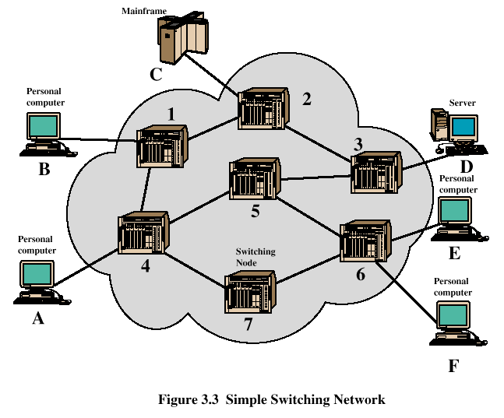
Switched Network
[Stallings., 2005]

Slide 4
Observations of Figure 3.3
Some nodes connect only to other nodes (e.g., 5 and 7)
Some nodes connect to one or more stations
Node-station links usually dedicated point-to-point links
Node-node links usually multiplexed links
  Frequency-division multiplexing (FDM)
  Time-division multiplexing (TDM)
Not a direct link between every node pair
[Stallings., 2005]

Slide 5
Techniques Used in Switched Networks
Circuit switching
  Dedicated communications path between two stations
  E.g., public telephone network
Packet switching
  Message is broken into a series of packets
  Each node determines next leg of transmission for each packet
[Stallings., 2005]

Slide 6
Phases of Circuit Switching
Circuit establishment
  An end to end circuit is established through switching nodes
Information Transfer
  Information transmitted through the network
  Data may be analog voice, digitized voice, or binary data
Circuit disconnect
  Circuit is terminated
  Each node deallocates dedicated resources
[Stallings., 2005]

Slide 7
Characteristics of Circuit Switching
Can be inefficient
  Channel capacity dedicated for duration of connection
  Utilization not 100%
  Delay prior to signal transfer for establishment
Once established, network is transparent to users
Information transmitted at fixed data rate with only propagation delay
[Stallings., 2005]

Slide 8
Components of Public Telecommunications Network
Subscribers - devices that attach to the network; mostly telephones
Subscriber line - link between subscriber and network
  Also called subscriber loop or local loop
Exchanges - switching centers in the network
  A switching centers that support subscribers is an end office
Trunks - branches between exchanges
[Stallings., 2005]

Slide 9
How Packet Switching Works
Data is transmitted in blocks, called packets
Before sending, the message is broken into a series of packets
  Typical packet length is 1000 octets (bytes)
  Packets consists of a portion of data plus a packet header that includes control information
At each node en route, packet is received, stored briefly and passed to the next node
[Stallings., 2005]

Slide 10
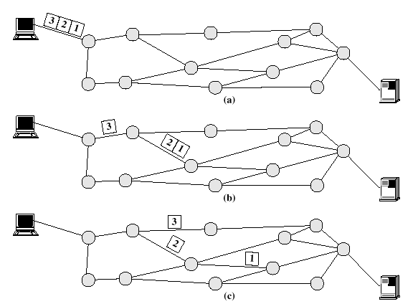
Packet Switching
[Stallings., 2005]

Slide 11
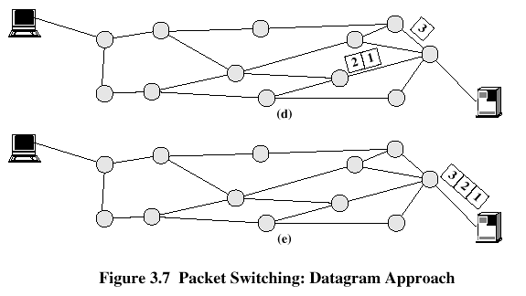
Packet Switching
[Stallings., 2005]

Slide 12
Packet Switching Advantages
Line efficiency is greater
  Many packets over time can dynamically share the same node to node link
Packet-switching networks can carry out data-rate conversion
  Two stations with different data rates can exchange information
Unlike circuit-switching networks that block calls when traffic is heavy, packet-switching still accepts packets, but with increased delivery delay
Priorities can be used
[Stallings., 2005]

Slide 13
Disadvantages of Packet Switching
Each packet switching node introduces a delay
Overall packet delay can vary substantially
  This is referred to as jitter
  Caused by differing packet sizes, routes taken and varying delay in the switches
Each packet requires overhead information
  Includes destination and sequencing information
  Reduces communication capacity
More processing required at each node
[Stallings., 2005]

Slide 14
Packet Switching Networks - Datagram
Each packet treated independently, without reference to previous packets
Each node chooses next node on packet’s path
Packets don’t necessarily follow same route and may arrive out of sequence
Exit node restores packets to original order
Responsibility of exit node or destination to detect loss of packet and how to recover
[Stallings., 2005]

Slide 15
Packet Switching Networks – Datagram
Advantages:
  Call setup phase is avoided
  Because it’s more primitive, it’s more flexible
  Datagram delivery is more reliable
[Stallings., 2005]

Slide 16
Packet Switching Networks – Virtual Circuit
Preplanned route established before packets sent
All packets between source and destination follow this route
Routing decision not required by nodes for each packet
Emulates a circuit in a circuit switching network but is not a dedicated path
  Packets still buffered at each node and queued for output over a line
[Stallings., 2005]

Slide 17
Packet Switching Networks – Virtual Circuit
Advantages:
  Packets arrive in original order
  Packets arrive correctly
  Packets transmitted more rapidly without routing decisions made at each node
[Stallings., 2005]

Slide 18
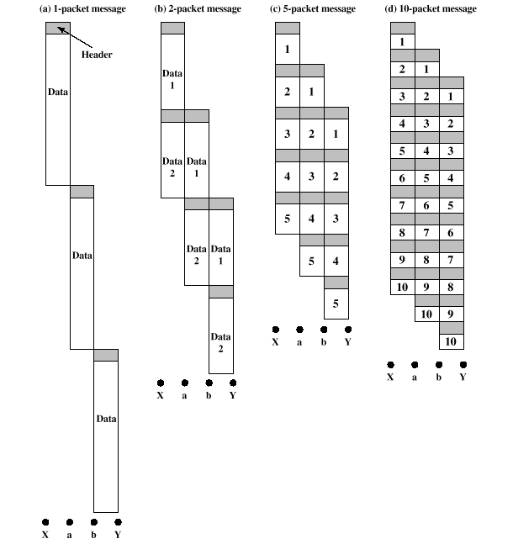
Effect of Packet Size on Transmission
[Stallings., 2005]

Slide 19
Effect of Packet Size on Transmission
Breaking up packets decreases transmission time because transmission is allowed to overlap
Figure 3.9a
  Entire message (40 octets) + header information (3 octets) sent at once
  Transmission time: 129 octet-times
Figure 3.9b
  Message broken into 2 packets (20 octets) + header (3 octets)
  Transmission time: 92 octet-times
[Stallings., 2005]

Slide 20
Effect of Packet Size on Transmission
Figure 3.9c
  Message broken into 5 packets (8 octets) + header (3 octets)
  Transmission time: 77 octet-times
Figure 3.9d
  Making the packets too small, transmission time starts increases
  Each packet requires a fixed header; the more packets, the more headers
[Stallings., 2005]

Slide 21
Key Features of a Protocol
Syntax
  Concerns the format of the data blocks
Semantics
  Includes control information for coordination and error handling
Timing
  Includes speed matching and sequencing
[Stallings., 2005]

Slide 22
Agents Involved in Communication
Applications
  Exchange data between computers (e.g., electronic mail)
Computers
  Connected to networks
Networks
  Transfers data from one computer to another
[Stallings., 2005]

Slide 23
TCP/IP Layers
Physical layer
Network access layer
Internet layer
Host-to-host, or transport layer
Application layer
[Stallings., 2005]

Slide 24
TCP/IP Physical Layer
Covers the physical interface between a data transmission device and a
transmission medium or network
Physical layer specifies:
  Characteristics of the transmission medium
  The nature of the signals
  The data rate
  Other related matters
[Stallings., 2005]

Slide 25
TCP/IP Network Access Layer
Concerned with the exchange of data between an end system and the network to which it's attached
Software used depends on type of network
  Circuit switching
  Packet switching (e.g., X.25)
  LANs (e.g., Ethernet)
  Others
[Stallings., 2005]

Slide 26
T:TCP/IP Internet Layer
Uses internet protocol (IP)
Provides routing functions to allow data to traverse multiple interconnected networks
Implemented in end systems and routers
[Stallings., 2005]

Slide 27
TCP/IP Host-to-Host, or Transport Layer
Commonly uses transmission control protocol (tcp)
Provides reliability during data exchange
  Completeness
  Order
[Stallings., 2005]

Slide 28
TCP/IP Application Layer
Logic supports user applications
Uses separate modules that are peculiar to each different type of application
[Stallings., 2005]

Slide 29
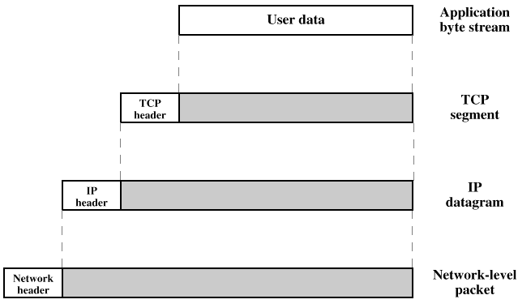
Protocol Data Units (PDUs)
[Stallings., 2005]

Slide 30
Common TCP/IP Applications
Simple mail transfer protocol (SMTP)
  Provides a basic electronic mail facility
File Transfer Protocol (FTP)
  Allows files to be sent from one system to another
TELNET
  Provides a remote logon capability
[Stallings., 2005]

Slide 31
Layers of the OSI Model
Application
Presentation
Session
Transport
Network
Data link
Physical
[Stallings., 2005]

Slide 32
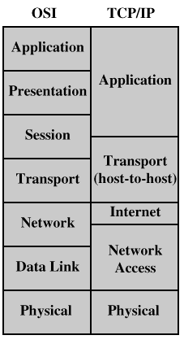
Comparison of OSI and TCP/IP
[Stallings., 2005]

Slide 33
TCP/IP Architecture Dominance
TCP/IP protocols matured quicker than similar OSI protocols
  When the need for interoperability across networks was recognized, only TCP/IP was available and ready to go
OSI model is unnecessarily complex
  Accomplishes in seven layers what TCP/IP does with fewer layers
[Stallings., 2005]

Slide 34
Elements of Standardization within OSI Framework
Protocol Specification
  Format of protocol data units (PDUs) exchanged
  Semantics of all fields
  Allowable sequence of PDUs
Service Definition
  Functional description that defines what services are provided, but not how the services are to be provided
Addressing
  Entities are referenced by means of a service access point (SAP)
[Stallings., 2005]

Slide 35
Internetworking Terms
Communication network – facility that provides a data transfer service among devices attached to the network
Internet – collection of communication networks, interconnected by bridges/routers
Intranet – internet used by an organization for internal purposes
  Provides key Internet applications
  Can exist as an isolated, self-contained internet
[Stallings., 2005]

Slide 36
Internetworking Terms
End System (ES) – device used to support end-user applications or services
Intermediate System (IS) – device used to connect two networks
Bridge – an IS used to connect two LANs that use similar LAN protocols
Router - an IS used to connect two networks that may or may not be similar
[Stallings., 2005]

Slide 37
Functions of a Router
Provide a link between networks
Provide for the routing and delivery of data between processes on end systems attached to different networks
Provide these functions in such a way as not to require modifications of the networking architecture of any of the attached subnetworks
[Stallings., 2005]

Slide 38
Network Differences Routers Must Accommodate
Addressing schemes
  Different schemes for assigning addresses
Maximum packet sizes
  Different maximum packet sizes requires segmentation
Interfaces
  Differing hardware and software interfaces
Reliability
  Network may provide unreliable service
[Stallings., 2005]

